Slide 1
CSC 236
Tutorial 3 - Daniel Razavi

Slide 2
Marks For The Problem Set and My Plan

Slide 3
Today’s Tutorial Problems

Slide 4


Slide 5
Big O
Big Ω

Slide 6

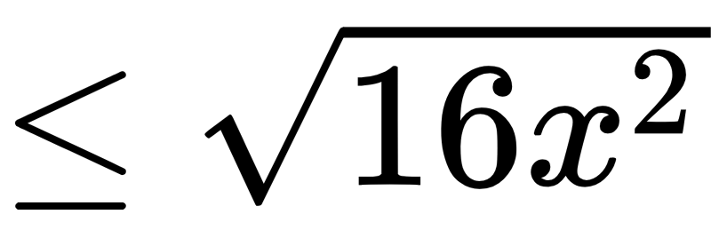
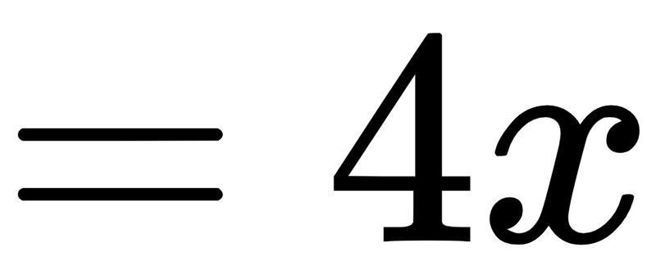
Big O
For x >= 0
We chose n₀=0 and c = 4
Therefore = O(x)

Slide 7
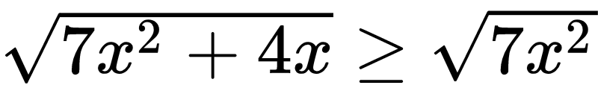
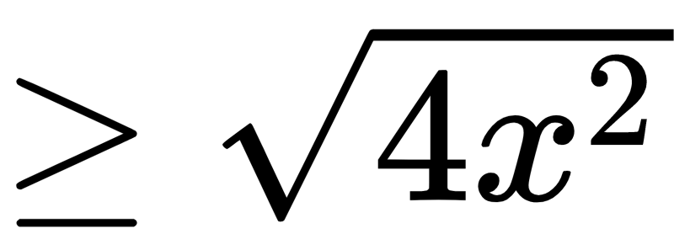
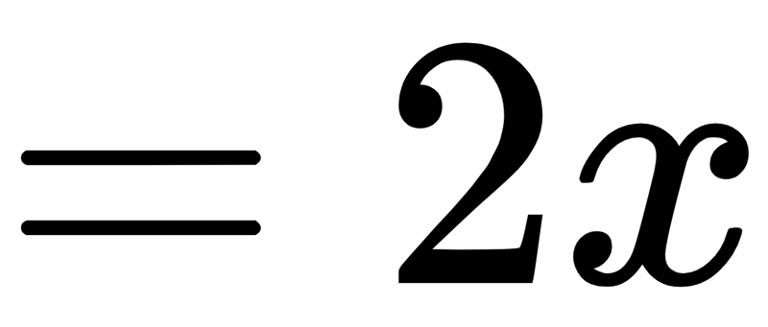
Big O:
For x being greater or equal to 0
Big Ω
For x >= 0
We chose n₀=0 and c = 2
Therefore = Ω(x)

Slide 8
Big O:
Big Ω
For x being greater or equal to 0
For x >= 0
Since we proved both, we know that this holds:

Slide 9
Base of 2 is the default base of log in this course

Slide 10
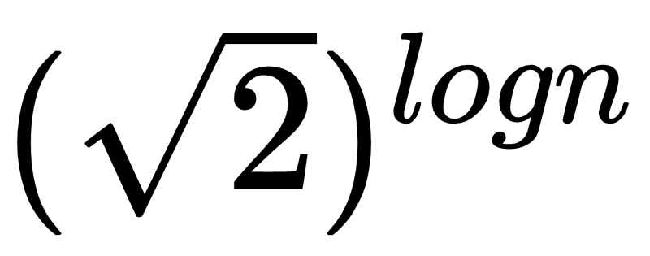
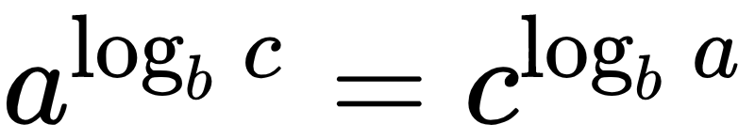
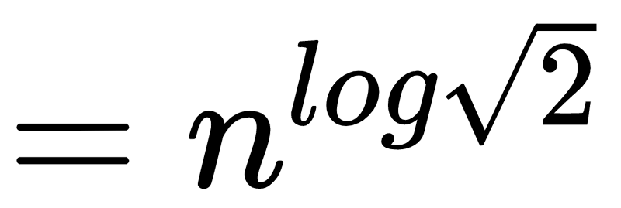
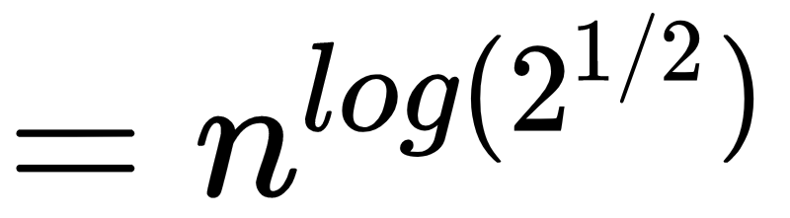
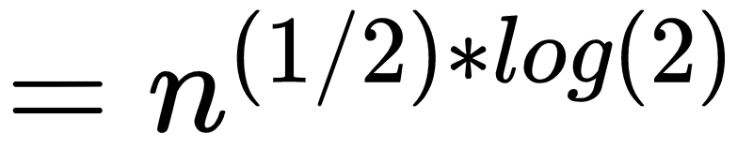
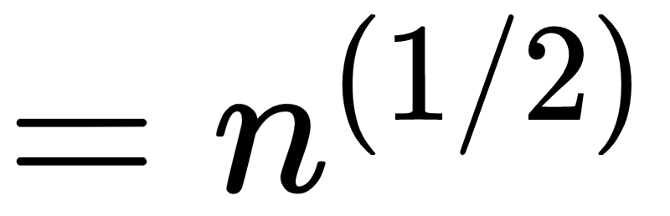
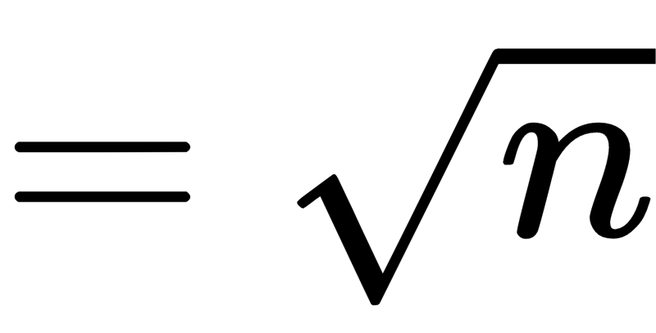
using the identity:

Slide 11
Note that we had no inequalities anywhere. So we've done both the big Ω and big O proofs at the same time; c can be set to 1 and n₀ to any value.

Slide 12
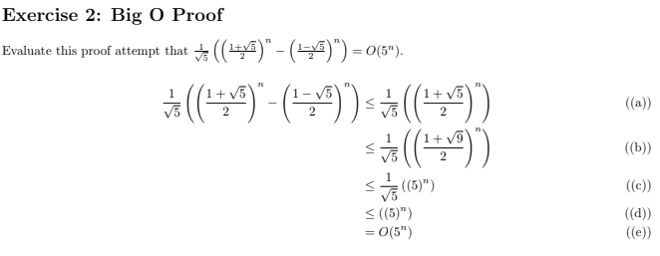
Potential Solution:
Basically Show me What’s Wrong With This Inequality

Slide 13
PROBLEM IN ((a))

Slide 14
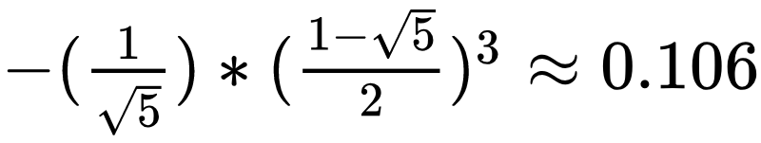
PROBLEM IN ((a))
we are hoping that this term is always negative. If it were always negative, then removing it is valid in a big-O proof.
However, this term is NOT always negative. For example, substitute an odd value of n, e.g. n = 3:

Slide 15
PROBLEM IN ((a))
we are hoping that this term is always negative. If it were always negative, then removing it is valid in a big-O proof.
However, this term is NOT always negative.
So, removing this term is not justified.

Slide 16

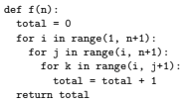

Slide 17
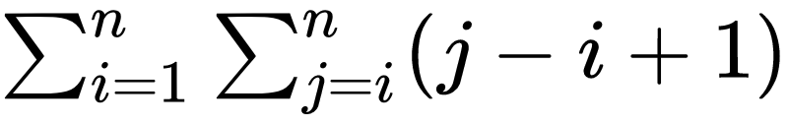
The Sum is:

Slide 18
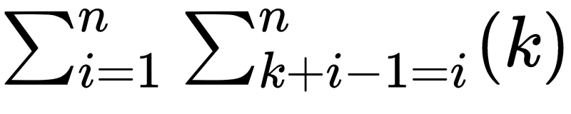
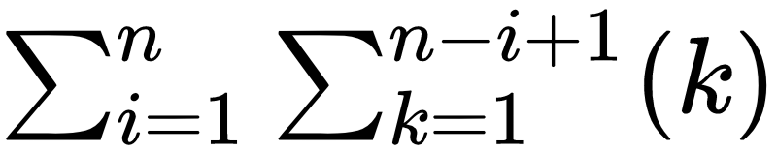
The Sum is:
Or if you don’t get this ^^^
let k = j-i+1, then j = k+i-1
OR

Slide 19
The Sum is:
Or if you don’t get this ^^^
let k = j-i+1, then j = k+i-1
OR
Let’s Keep this in mind

Slide 20
The Sum is:

Slide 21
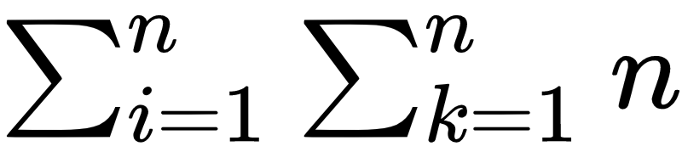
The Sum is:
This is Upper Bounded By:

Slide 22
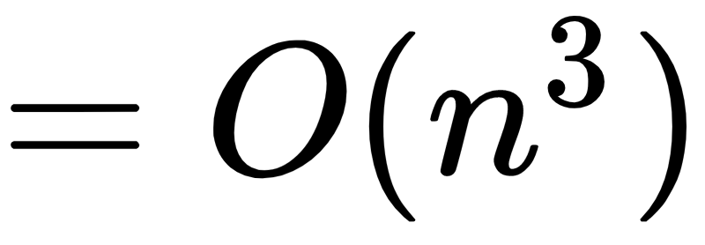
The Sum is:
This is Upper Bounded By:
So Big O

Slide 23
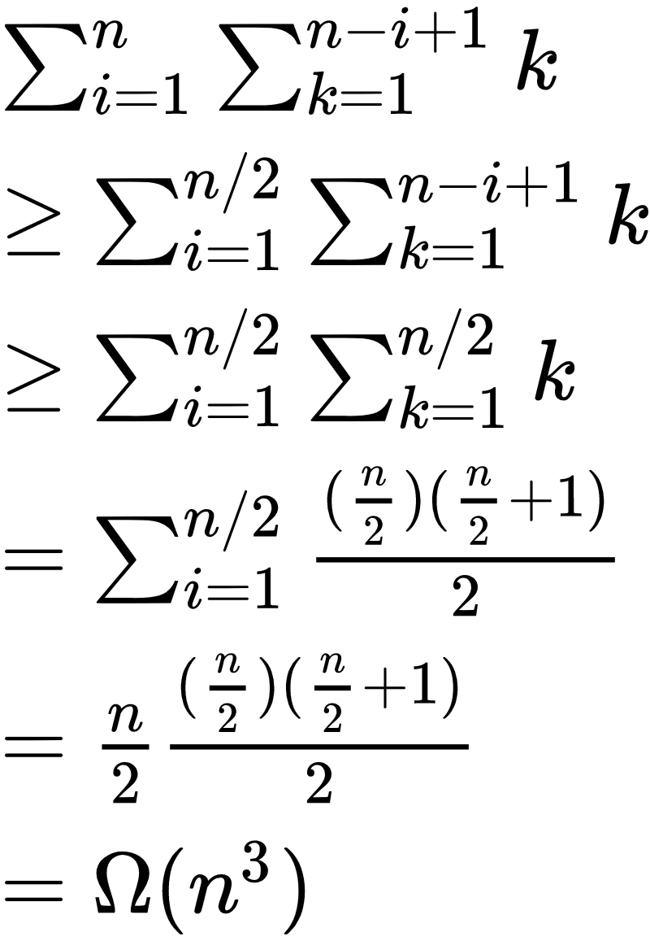
For the lower-bound, assume for simplicity that n is even. Then:
Notes:
Latex for this thing:
\sum_{i=1}^{n} \sum_{k=1}^{n-i+1} k \\
\ge \sum_{i=1}^{n/2} \sum_{k=1}^{n-i+1} k \\
\ge \sum_{i=1}^{n/2} \sum_{k=1}^{n/2} k \\
=\sum_{i=1}^{n/2} \frac{(\frac{n}{2})(\frac{n}{2}+1)}{2}\\
=\frac{n}{2}\frac{(\frac{n}{2})(\frac{n}{2}+1)}{2}\\
= \Omega(n^3)

Slide 24
For the lower-bound, assume for simplicity that n is even. Then:
Take Only the first n/2 terms
Notes:
Latex for this thing:
\sum_{i=1}^{n} \sum_{k=1}^{n-i+1} k \\
\ge \sum_{i=1}^{n/2} \sum_{k=1}^{n-i+1} k \\
\ge \sum_{i=1}^{n/2} \sum_{k=1}^{n/2} k \\
=\sum_{i=1}^{n/2} \frac{(\frac{n}{2})(\frac{n}{2}+1)}{2}\\
=\frac{n}{2}\frac{(\frac{n}{2})(\frac{n}{2}+1)}{2}\\
= \Omega(n^3)

Slide 25
For the lower-bound, assume for simplicity that n is even. Then:
Take Only the first n/2 terms
When i = n/2, the k sum has n/2 terms. For any other value of i, the k sum has more than n/2 terms. So, for each value of i, the k sum has at least n/2 terms.
Notes:
Latex for this thing:
\sum_{i=1}^{n} \sum_{k=1}^{n-i+1} k \\
\ge \sum_{i=1}^{n/2} \sum_{k=1}^{n-i+1} k \\
\ge \sum_{i=1}^{n/2} \sum_{k=1}^{n/2} k \\
=\sum_{i=1}^{n/2} \frac{(\frac{n}{2})(\frac{n}{2}+1)}{2}\\
=\frac{n}{2}\frac{(\frac{n}{2})(\frac{n}{2}+1)}{2}\\
= \Omega(n^3)

Slide 26
For the lower-bound, assume for simplicity that n is even. Then:
Take Only the first n/2 terms
When i = n/2, the k sum has n/2 terms. For any other value of i, the k sum has more than n/2 terms. So, for each value of i, the k sum has at least n/2 terms.
Simplifying the Summations
Notes:
Latex for this thing:
\sum_{i=1}^{n} \sum_{k=1}^{n-i+1} k \\
\ge \sum_{i=1}^{n/2} \sum_{k=1}^{n-i+1} k \\
\ge \sum_{i=1}^{n/2} \sum_{k=1}^{n/2} k \\
=\sum_{i=1}^{n/2} \frac{(\frac{n}{2})(\frac{n}{2}+1)}{2}\\
=\frac{n}{2}\frac{(\frac{n}{2})(\frac{n}{2}+1)}{2}\\
= \Omega(n^3)

Slide 27
For the lower-bound, assume for simplicity that n is even. Then:
Take Only the first n/2 terms
When i = n/2, the k sum has n/2 terms. For any other value of i, the k sum has more than n/2 terms. So, for each value of i, the k sum has at least n/2 terms.
Simplifying the Summations
So Big Ω
Notes:
Latex for this thing:
\sum_{i=1}^{n} \sum_{k=1}^{n-i+1} k \\
\ge \sum_{i=1}^{n/2} \sum_{k=1}^{n-i+1} k \\
\ge \sum_{i=1}^{n/2} \sum_{k=1}^{n/2} k \\
=\sum_{i=1}^{n/2} \frac{(\frac{n}{2})(\frac{n}{2}+1)}{2}\\
=\frac{n}{2}\frac{(\frac{n}{2})(\frac{n}{2}+1)}{2}\\
= \Omega(n^3)

Slide 28
For the lower-bound, assume for simplicity that n is even. Then:
Take Only the first n/2 terms
When i = n/2, the k sum has n/2 terms. For any other value of i, the k sum has more than n/2 terms. So, for each value of i, the k sum has at least n/2 terms.
Simplifying Summations
So Big Ω
∴ Since both Big Ω and Big O were Proven, 𝛳(n³) holds.
Notes:
Latex for this thing:
\sum_{i=1}^{n} \sum_{k=1}^{n-i+1} k \\
\ge \sum_{i=1}^{n/2} \sum_{k=1}^{n-i+1} k \\
\ge \sum_{i=1}^{n/2} \sum_{k=1}^{n/2} k \\
=\sum_{i=1}^{n/2} \frac{(\frac{n}{2})(\frac{n}{2}+1)}{2}\\
=\frac{n}{2}\frac{(\frac{n}{2})(\frac{n}{2}+1)}{2}\\
= \Omega(n^3)

Slide 29
sum i 1 to n. sum j i to n. sum k i to j. 1
= sum i 1 to n. sum j i to n. (j-i+1)
= sum i 1 to n. sum j i to n. j
- sum i 1 to n. sum j i to n. i
+ sum i 1 to n. sum j i to n. 1
= sum i 1 to n. sum j i to n. j
- sum i 1 to n. sum j i to n. i
+ sum i 1 to n. (n-i+1)
>= sum i 1 to n. sum j i to n. j
- sum i 1 to n. sum j i to n. i
= sum i 1 to n. sum j i to n. j
- sum i 1 to n. i*(n-i+1)
= sum i 1 to n. sum j i to n. j
- sum i 1 to n. i*n
+ sum i 1 to n. i*i
- sum i 1 to n. i
= sum i 1 to n. sum j i to n. j
- n * n(n+1)/2
+ sum i 1 to n. i*i
- n(n+1)/2
= sum i 1 to n. sum j i to n. j
- n * n(n+1)/2
+ n(n+1)(2n+1)/6
- n(n+1)/2
= sum i 1 to n. (n(n+1)/2 - i(i-1)/2
- n * n(n+1)/2
+ n(n+1)(2n+1)/6
- n(n+1)/2
= sum i 1 to n. (n(n+1)/2
- sum i 1 to n. i(i-1)/2
- n * n(n+1)/2
+ n(n+1)(2n+1)/6
- n(n+1)/2
= n*n(n+1)/2
- sum i 1 to n. i(i-1)/2
- n * n(n+1)/2
+ n(n+1)(2n+1)/6
- n(n+1)/2
= n*n(n+1)/2
- sum i 1 to n. (1/2)i*i
+ sum i 1 to n. (1/2)i
- n * n(n+1)/2
+ n(n+1)(2n+1)/6
- n(n+1)/2
>= n*n(n+1)/2
- sum i 1 to n. (1/2)i*i
- n * n(n+1)/2
+ n(n+1)(2n+1)/6
- n(n+1)/2
= n*n(n+1)/2
- (1/2)n*(n+1)(2n+1)/6
- n * n(n+1)/2
+ n(n+1)(2n+1)/6
- n(n+1)/2
= n*n(n+1)/2
- n*(n+1)(2n+1)/12
- n * n(n+1)/2
+ n(n+1)(2n+1)/6
- n(n+1)/2
= n(n+1)(2n+1)/12
- n(n+1)/2
= (n^2+n)(2n+1)/12 - (n^2+n)/2
= 2n^3/12+n^2/12+2n^2/12+n/12-n^2/2-n/2
= n^3/6+n^2/12+n^2/6+n/12-n^2/2-n/2
>= n^3/6-n^2/2-n/2
>= n^3/6-n^2/2-n^2/2
= n^3/6-n^2
>= (1/6)n^3-(1/10)n^3, if n >= 10
= (1/15)n^3
So, choose c = 1/15, n0 = 10
Professor: There's a good reason for the change of variables in the sum. If we try to get a lower-bound directly, it's a mess -- read at your own risk, and don't share too much of this with students (not a good use of time):
Sorry for not putting into latex format like the rest of the presentation, this slide is for home not the tutorial.

Slide 30
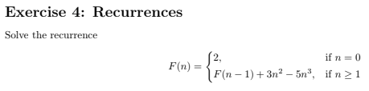

Slide 31
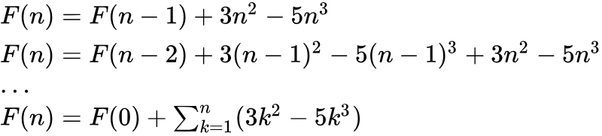

Slide 34

Using some well known Identities
Useful File On Website

Slide 35
Using some well known Identities
Useful File On Website
That’s Pretty Much it!

Slide 36
CSC 236
Tutorial 3 - Daniel Razavi

